Slide 1
Practical No -7
FLSM (Fixed length subnet Mask )

Slide 2
What is Subnetting?
Subnetting means dividing a network into multiple small networks. We use subnetting mainly to save the wastage of IP addresses. We will be discussing here the subnetting of classful addressing. There are two types of subnetting,
FLSM (Fixed Length Subnet Mask)
VLSM (Variable Length Subnet Mask)

Slide 3
What is FLSM?
FLSM ( fixed length subnet mask) refers to a type of provider networking in which a block of IP addresses is divided into multiple subnets of equal length, i.e. an equal number of IP addresses.
FLSM stands for Fixed Length Subnet Mask. In it, we break the default IP subnet into the same-sized subnets. For example, if the default subnet has 12 IP addresses, we can break it into three equal-sized subnets having 4 IP addresses in each.

Slide 4
Example of subnetting 10.0.0.1/26
Step -1 The value of 64 hosts is 2^{6.}
^{Step -2 -}
Total bits - Subnetting mask = 32- 26 = 6 bits.
Step -3 – IPv4 is 32 bits, divided into 4 equal parts.
8 +8+8 + 11000000 = 128 +64 =192.
Step -4 - Find the host addresses.
^{255- 192 = 63.}
The network range we can give to network hosts is from 0 to 63.
^{Subnet mask = 255.255.255.192.}

Slide 5
How to find the Host address.
Network ID is - 10.0.0.1/26 ,Host addresses – 10.0.0.1- 10.0.0.62
Broadcast Id - 10.0.0.63.
Network ID starts from 10.0.0.64, Host address-10.0.0.65 – 10.0.0.126
Broadcast Id – 10.0.0.127.
Network ID Starts from 10.0.0.128,Host Address – 10.0.0.129 - 10.0.0.190,
Broadcast ID – 10.0.0.191.
Network ID Starts from 10.0.0.192 ,Host Address – 10.0.0.193 - 10.0.0.254,
Broadcast ID – 10.0.0.255.

Slide 6
IP Address: 1.0.0.1/2
Step -1 The value of 2 hosts is 2^{1.}
^{Step -2 -}
Total bits - Subnetting mask = 32- 2 = 30 bits.
Step -3 – IPv4 is 32 bits, divided into 4 equal parts.
⁸ ⁺⁸⁺⁸ ⁺ ¹¹¹¹¹¹⁰⁰ ⁼ ¹²⁸
Step -4 - Find the host addresses.
^{255- 128 = 127.}
The network range we can give to network hosts is from 0 to 127.
Subnet mask = 255.255.255. 128.

Slide 7
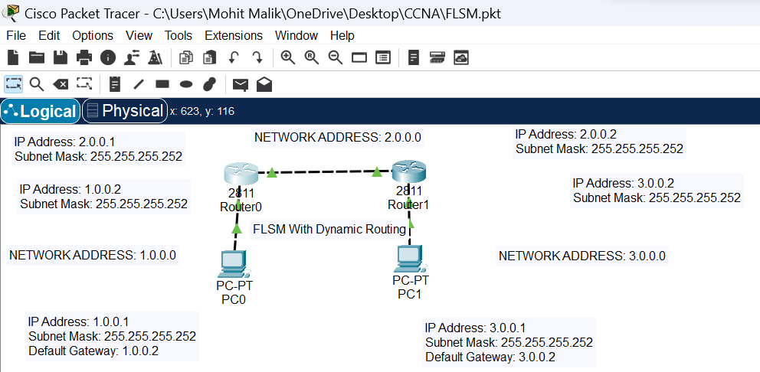
Implementation of FLSM by giving the subnet mask 255.255.255.252.
The formula for finding the host addresses = 255- 252 = 3 hosts.

Slide 8
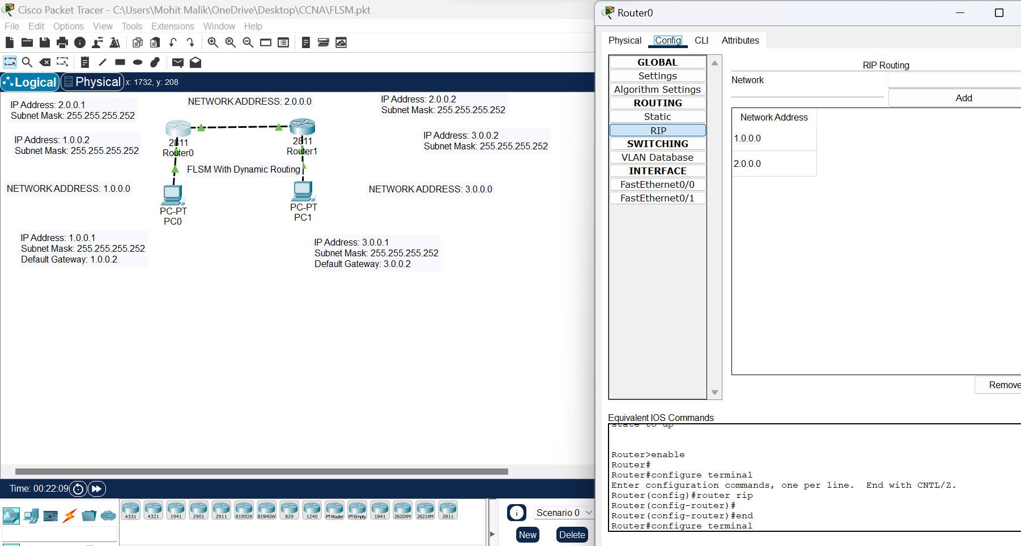
To solve the FLSM we can use Dynamic routing on router 0.

Slide 9
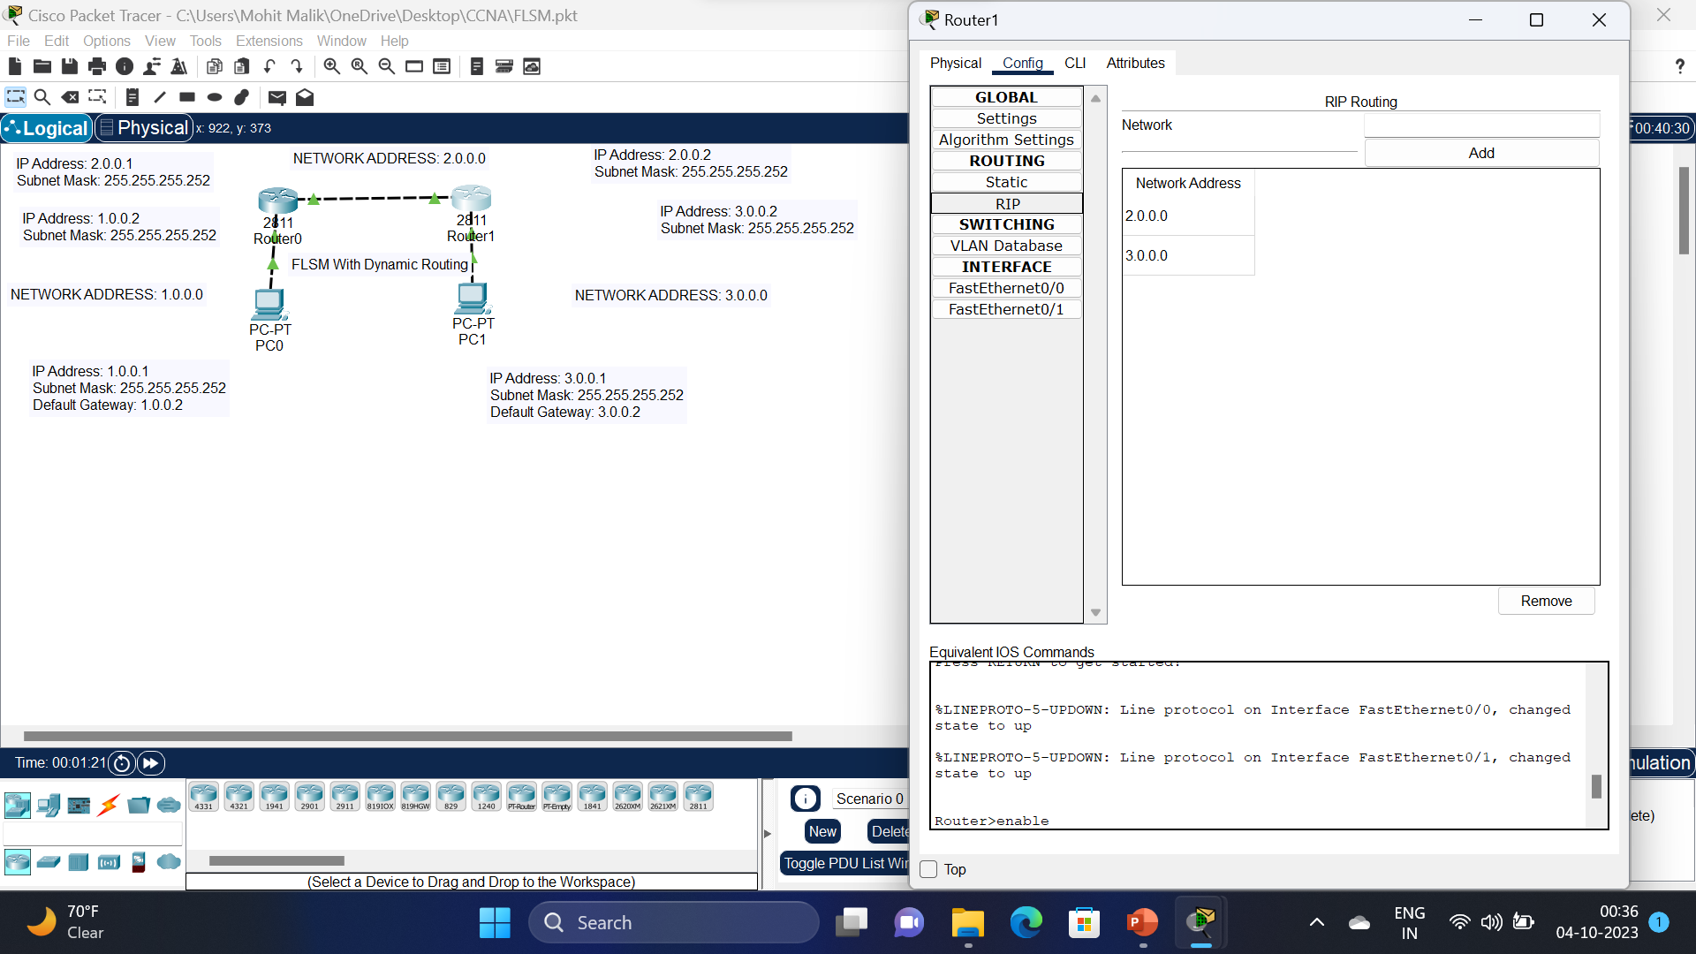
To solve the FLSM we can use Dynamic routing on router 1.

Slide 10
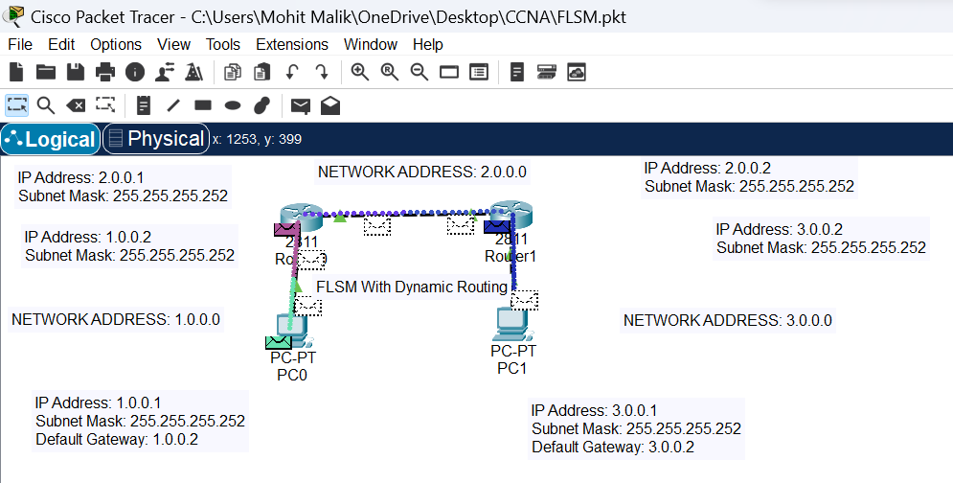
Message can be sent from PC0 to PC1.

Slide 11


